Slide 1

Iteration Zero – setting up for sustainable software
Jeffrey Palermo
Managing Partner & CEO, Clear Measure
@jeffreypalermo
jeffrey@clear-measure.com

Slide 2
Agenda
What this talk is / what it is not
About myself (who cares, get with the goods!)
Why this matters (worldview)
Iteration zero agenda
SCM drill-down

Slide 3
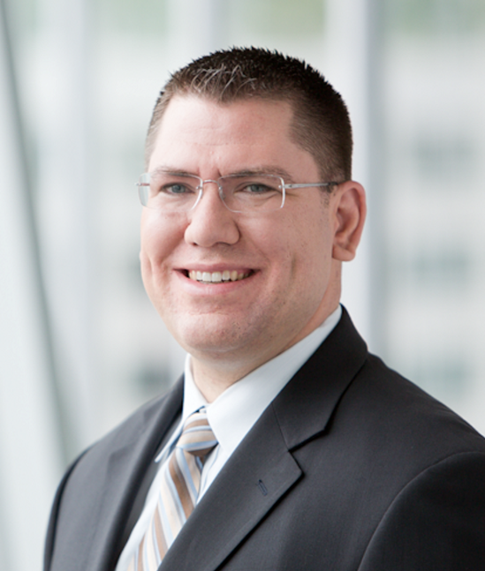

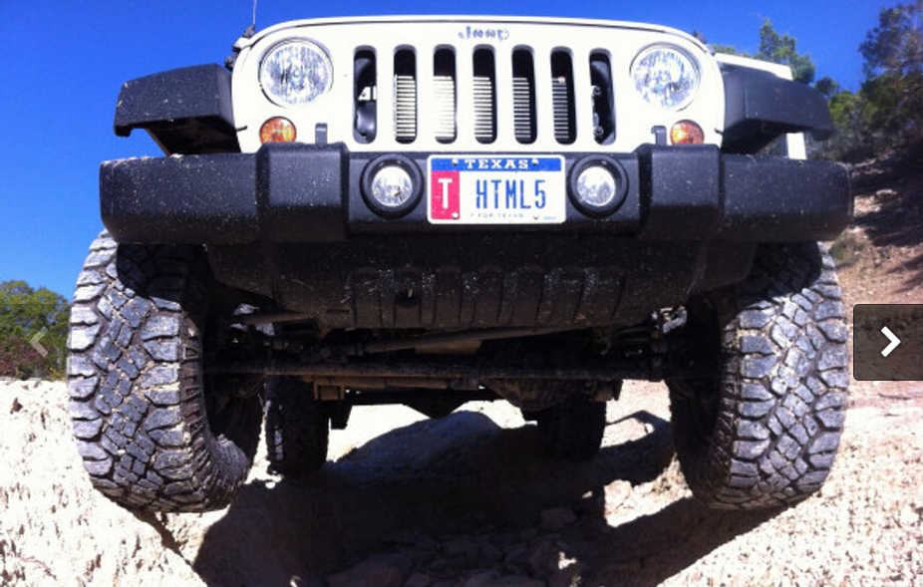
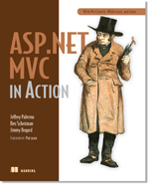

Who is this Jeffrey Palermo guy?
Personal
Father of three
Iraq veteran 2003-2004
Eagle Scout
Christian
Jeep off-roader
Professional
Programming for IIS since 1997
Written some articles, books, & blogs
Speaker at local conferences, MS Tech Ed, VS Live, DevTeach, etc
Ran Austin .Net User Group from 2005-2011
Microsoft MVP
http://www.safaribooksonline.com/library/view/aspnet-mvc-5/9780133892888/ google “safari online mvc 5 Palermo”
We are hiring!

Slide 4
Why Iteration Zero Matters

Slide 5
Things to establish
Problem – definition of success – mountain to be scaled
Solution – how to finish – how to solve problem
Architecture – what to build & tech stack to build with
SDLC – how to build it
DevOps – how to run it, version it, secure it, manage it

Slide 6
Architecture
Things that are expensive to change
Non-reversible decisions
Foundational elements
Platform
Type of system
Dependency management

Slide 7
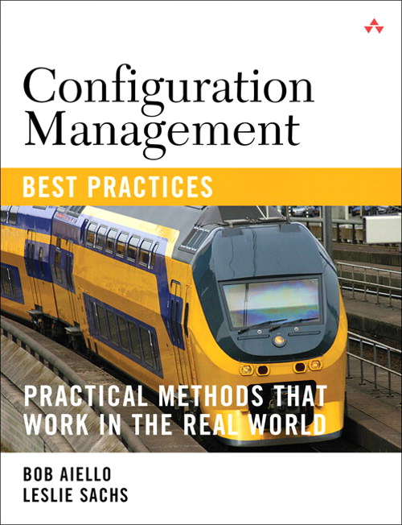
What is SCM? (one part of architecture)
What is Software Configuration Management
Source code management
Build engineering
Environment configuration
Change control
Release engineering
Deployment

Slide 8
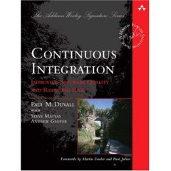
What is continuous integration?
It is the process of integrating small changes into the larger software system “early & often”
Creates frequent feedback in order to reduce the risks involved with changing your software system.
Reduces Risk by turning a large task into small bit sized chunks.

Slide 9
The Problem/Solution
“In my early days in the software industry, one of the most awkward and tense moments of a software project was integration. Modules that worked individually were put together and the whole usually failed in ways that were infuriatingly difficult to find. Yet in the last few years, integration has largely vanished as a source of pain for projects, diminishing to a nonevent.” – Martin Fowler, Foreword to Continuous Integration

Slide 10




Iteration Zero Goal (no features)
Developer
Developer
Source code management
Developer
Build engineering/ Environment configuration
Working
Software
Feedback

Slide 11
What to set up right away
Step 1 VCS
Source control structure
Gather dependencies
Step 2 Build
Compile
Step 3 Test
Deploy
Basic testing
Test
Package

Slide 12
Version Control System (VCS)
Also called Source Code Control (SCC)

Slide 13
Version control shapes your world-view
Locking
Non-Locking
Code is dangerous/risky to change
If someone is looking at a file, we need to keep others out
We need to be careful and intentional to keep the software stable
Code is safe/easy to change
It’s ok if multiple people change the same code file at the same time.
Sophisticated process and tools enable guaranteed recovery from any instability

Slide 14
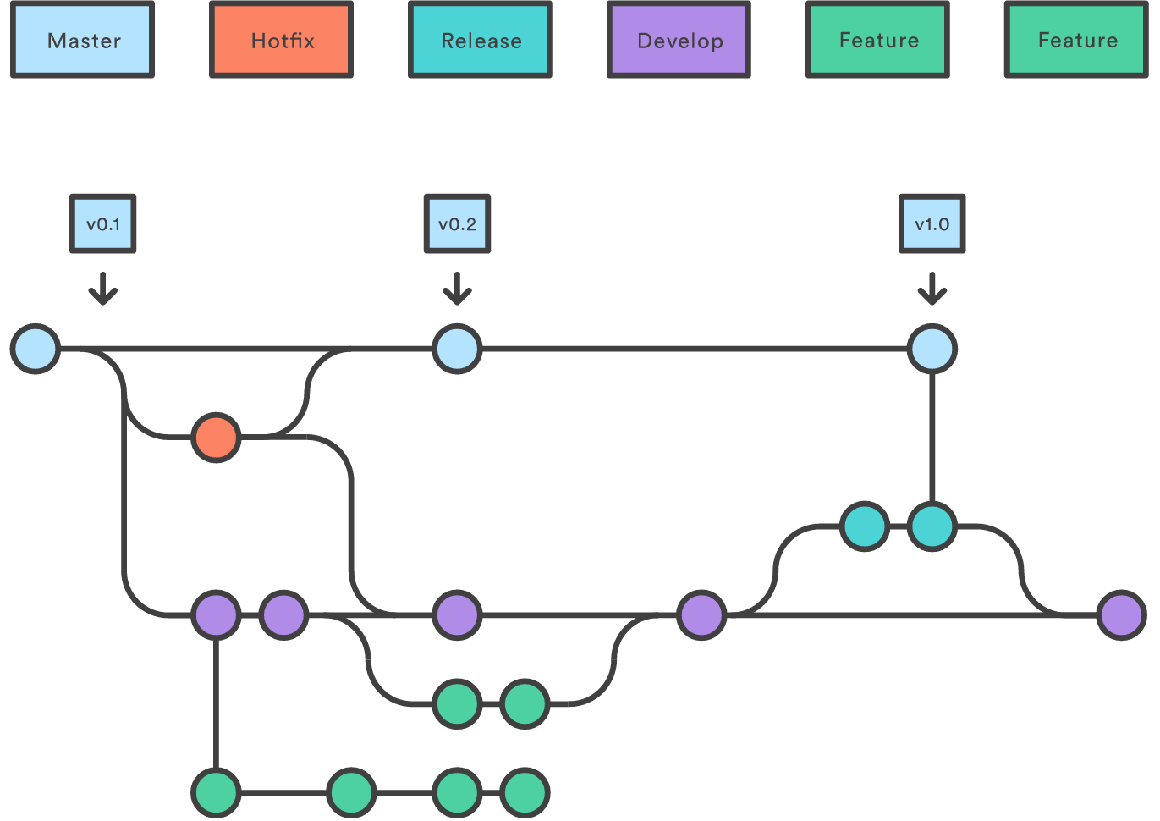
Git Flow https://www.atlassian.com/git/tutorials/comparing-workflows

Slide 15
VCS & VS Solution Setup w/ Onion Architecture (DEMO)
Temporarily ignoring application layers

Slide 16
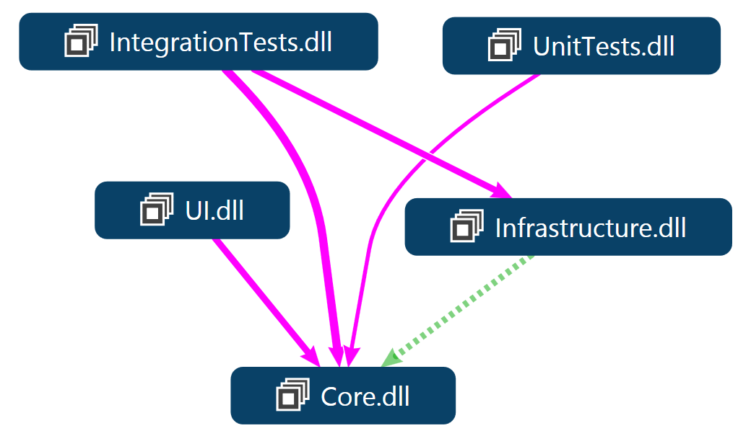
ASP.NET MVC Solution Structure Onion Architecture pattern

Slide 17
Build the software
Anyone heard of continuous integration?

Slide 18
Build engineering
Private Build – used by each developer to build and test their changes before they commit code to version control.
Integration Build – verifies each developers change against the entire systems. This ensures that the code in source control contains a working system.

Slide 19
Environment configuration
All configuration for the target environment should be done or simulated before each automated build.
Examples:
Database connection strings
Application config settings
Environment variables
Operating System settings
Web server settings

Slide 20
Demo agenda
Private build
Environment configuration(database)
Unit tests
Release packaging
Version, zip
Hook for Continuous Integration server (JetBrains TeamCity)
LET’S GO

Slide 21
SDLC – Software development lifecycle
Iteration Zero’s goal is to set team up for productivity
SDLC
Conceptual planning
Planning & requirements definition
Design
Development and testing
Implementation
Operations and maintenance
Disposition

Slide 22
SDLC – Quality overlay
Batch Size of 1
SDLC
Conceptual planning
Planning & requirements definition (define test method)
Design (and design tests)
Development and testing (automate & verify tests)
Implementation (run tests & execute deploy scripts)
Operations and maintenance
Disposition

Slide 23

Ask questions!
@jeffreypalermo
Jeffrey@clear-measure.com
512-298-2377
JeffreyPalermo.com

